Slide 1
COMP315 – Advanced Programming
OpenGL - Transformations and matrix stack
Deshen Moodley
2015

Slide 2
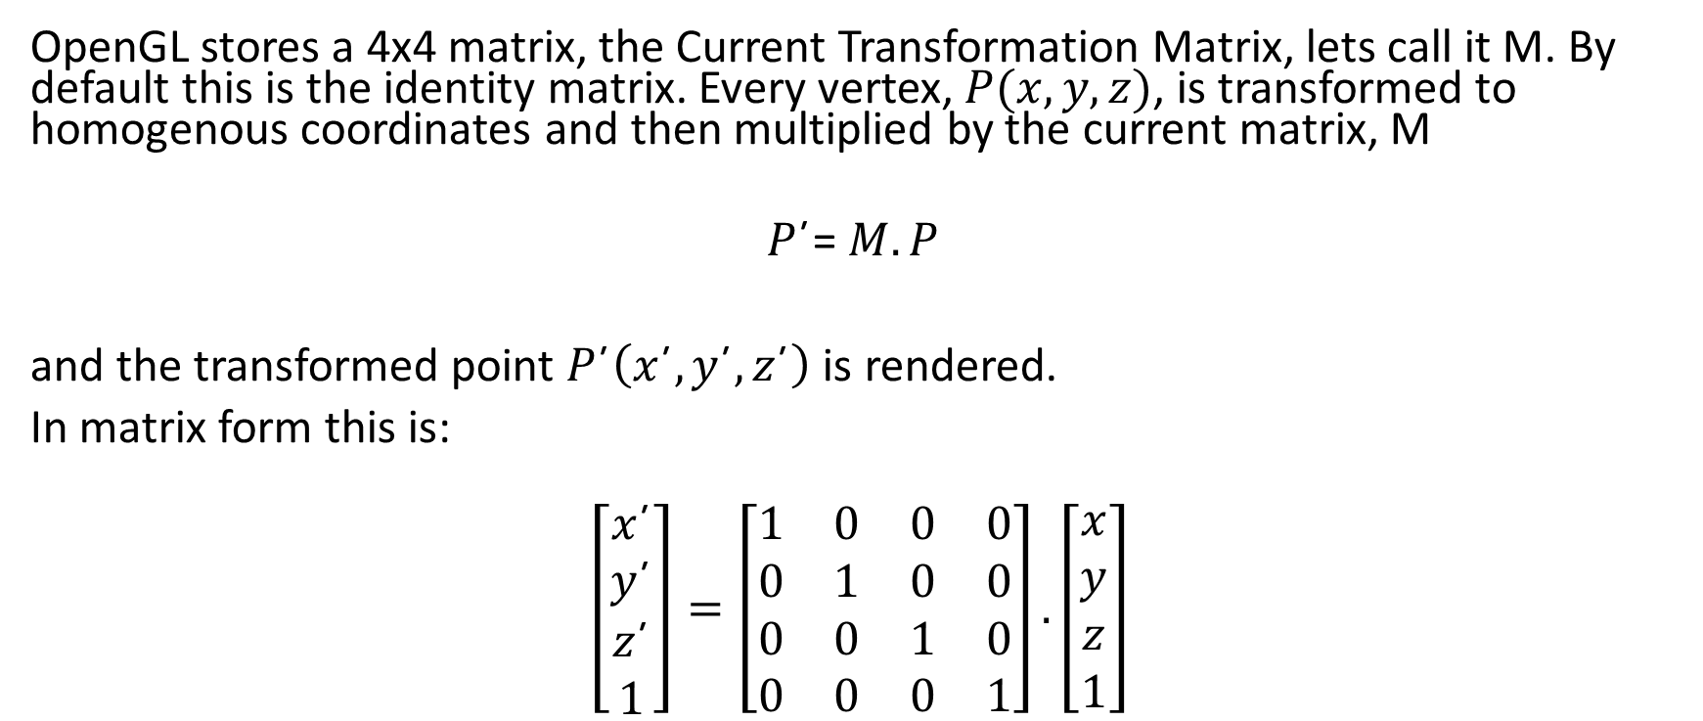
OGL – Current Transformation Matrix
OpenGL stores a 4x4 matrix, the Current Transformation Matrix, lets call it M. By default this is the identity matrix. Every vertex, $P(x,y,z)$, is transformed to homogenous coordinates and then multiplied by the current matrix, M
$$P\text{´}\text{=} M.P$$
and the transformed point $P\text{´}\left(x\text{´},y\text{´},z\text{´}\right)$ is rendered.
In matrix form this is:
$$\left[\begin{matrix}x\text{´} \\ y\text{´} \\ z\text{´} \\ 1\end{matrix}\right]=\left[\begin{matrix}1 & 0 & 0 & 0 \\ 0 & 1 & 0 & 0 \\ 0 & 0 & 1 & 0 \\ 0 & 0 & 0 & 1\end{matrix}\right].\left[\begin{matrix}x \\ y \\ z \\ 1\end{matrix}\right]$$

Slide 3
General transformation types
Three general transformations
Translation - moves the world along the x,y,z axis
Rotation - rotates the world counter-clockwise around the x,y,z axis
Scaling - magnifies or shrinks the world
3D case is a simple extension of 2D method for translation and scaling but more complicated for rotation
OpenGL provides the following function for 3D transformations
Translation - glTranslate(x,y,z)
Scaling - glScale(x,y,z)
Rotation - glRotate(angle, x, y, z)
See Nate Robbins Transformation tutor program

Slide 4
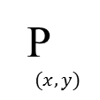
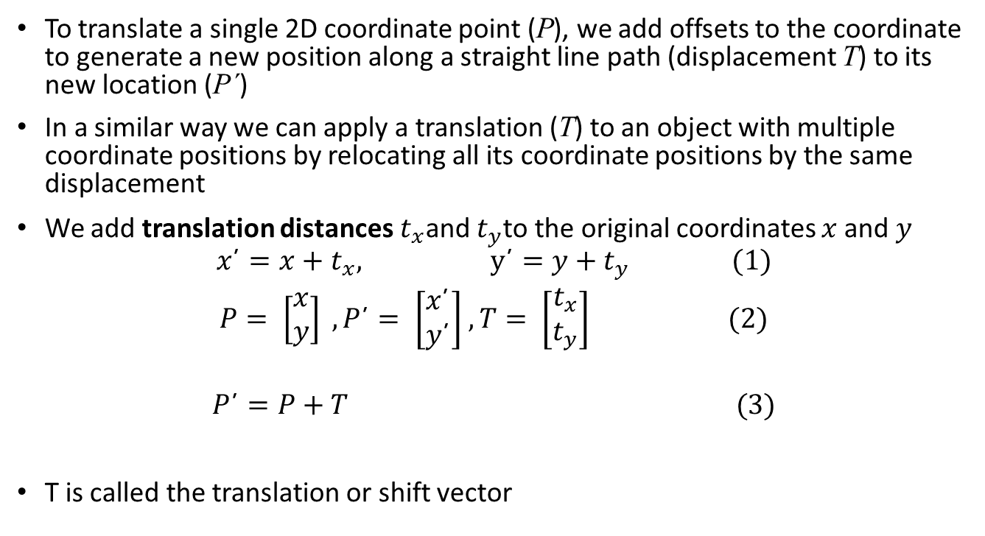

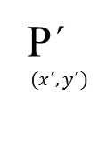
Translation -2D
T$(t_{x},t_{y})$
P´
$$(x\text{´},y\text{´})$$
To translate a single 2D coordinate point (P), we add offsets to the coordinate to generate a new position along a straight line path (displacement T) to its new location (P´)
In a similar way we can apply a translation (T) to an object with multiple coordinate positions by relocating all its coordinate positions by the same displacement
We add translation distances $t_{x}$and $t_{y}$to the original coordinates $x$and $y$
$$x\text{´}=x+t_{x}, \text{y}\text{´}=y+t_{y} (1)$$
$P= \left[\begin{matrix}x \\ y\end{matrix}\right] ,P\text{´}= \left[\begin{matrix}x\text{´} \\ y\text{´}\end{matrix}\right]$ $, T= \left[\begin{matrix}t_{x} \\ t_{y}\end{matrix}\right] (2)$
$$P\text{´}=P+T (3)$$
T is called the translation or shift vector
P
$$(x,y)$$

Slide 5
Translate example
glMatrixMode(GL_MODELVIEW); // To operate on Model-View matrix
glLoadIdentity(); // Reset the model-view matrix
glTranslatef(-0.5f, 0.4f, 0.0f); // Translate (x,y,z) left and up
glBegin(GL_QUADS); // Each set of 4 vertices form a quad
glColor3f(1.0f, 0.0f, 0.0f); // Red
glVertex2f(-0.3f, -0.3f); // Define vertices in counter-clockwise // (CCW) order
glVertex2f( 0.3f, -0.3f); // so that the normal (front-face) is // facing you
glVertex2f( 0.3f, 0.3f);
glVertex2f(-0.3f, 0.3f);
glEnd();

Slide 6
Rotation example
glRotatef(180.0f, 0.0f, 0.0f, 1.0f); // Rotate 180 degrees around the x
// axis (counterclockwise)
glBegin(GL_TRIANGLES); // Each set of 3 vertices form a triangle
glColor3f(1.0f, 0.0f, 0.0f); // Red
glVertex2f(-0.3f, -0.2f);
glColor3f(0.0f, 1.0f, 0.0f); // Green
glVertex2f( 0.3f, -0.2f);
glColor3f(0.0f, 0.0f, 1.0f); // Blue
glVertex2f( 0.0f, 0.3f);
glEnd();

Slide 7
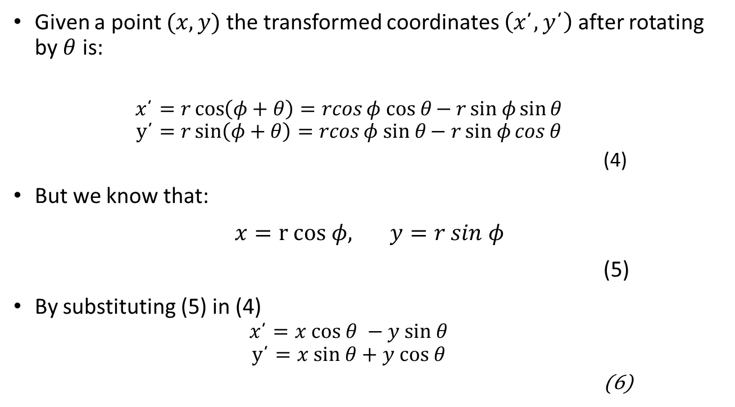





Rotation
$$y$$
Given a point $(x,y)$ the transformed coordinates $\left(x\text{´},y\text{´}\right)$ after rotating by $θ$ is:
$$x\text{´}=r\cos\left(φ+θ\right)=rcosφ cos θ{− rsin φ{\sin{θ}}}$$
$$y\text{´}=r\sin\left(φ+θ\right)=rcosφ sin θ{− rsin φ{\cos{θ}}}$$
(4)
But we know that:
$x=r cos φ, y=r sin φ$
(5)
By substituting (5) in (4)
$$x\text{´}=x cos θ −y sin θ$$
$$y\text{´}=x sin θ+y cos θ$$
(6)
$$(x\text{´},y\text{´})$$
θ
$$(x,y)$$
$$φ$$
$$x$$

Slide 8
Transformation example
Work through GL04ModelTransform.cpp program in the tutorial to gain an understanding of transformations on the world
Check Howard’s OpenGL Tutorial and Reference, page 49 to gain a better understanding of the OpenGL transformation commands

Slide 9
OGL – Current Transformation Matrix
Recall, OpenGL is state based so all change to the matrix is cumulative unless you clear it, so we can quickly start losing track of transformations
Example program – TransformExample.java
OGL maintains multiple matrices in a stack, with the CTM on the top
glPushMatrix() adds a new matrix (a copy of the current 1) to the stack and makes it the current matrix. All subsequent transformations are applied to this new matrix
glPopMatrix(), deletes the top matrix from the stack and makes the previous one the CTM
glLoadIdentity() loads the identity matrix into the CTM in column major form (col 1, col2 , col3, col 4)
glLoadMatrix() loads the identity matrix into the CTM in column major form
This is useful for hierarchical modelling, where we use simple objects (primitives) to compose complex scenes. We continuously change M (translate, rotate, scale) and then render some objects.

